Slide 1


DETECTION OF SLD IN KANNADA VOCABULARY AMONGST UNDERGRADUATE STUDENTS
Presented By :
Varun Urs M S 1BM20CS182
Vinay Kulkarni 1BM20CS188
Tushar B T 1BM20CS174
Umang Goel 1BM20CS176
Project Guide :
Dr. Kavitha Sooda
Professor
B. M. S. College of Engineering

Slide 2

Contents
Introduction
Problem Statement
Objectives
Base Paper Reference
Types of SLDs
Literature Survey
High Level Design
Data Acquisition
Image Preprocessing
Feature Extraction
Proposed Models

Slide 3
Introduction : Background
General Overview
History
Slow learning disorder, also known as specific learning disorder (SLD) or learning disability, refers to a neurological condition that affects how an individual learns and processes information. People with this disorder may have difficulty with reading, writing, math, or other skills.
Despite having normal intelligence and opportunities for learning, the person subjected to such disorder show a set of symptoms like unclear, irregular writing with inconsistent slants and shapes.
1

Slide 4

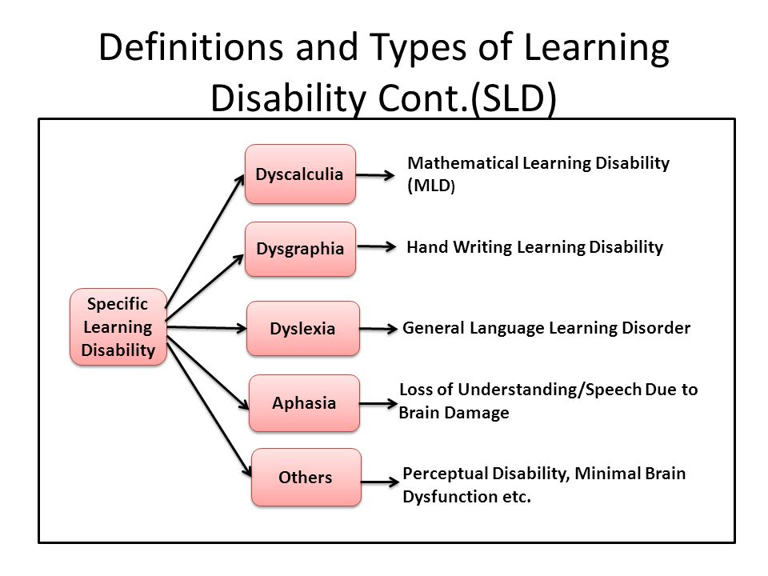
Types of Specific Learning Disabilities
2

Slide 5
Problem Statement
Children with SLDs often face difficulties in writing, which can lead to academic and social challenges.
Traditional methods of identifying this condition are time-consuming and subjective, and may not accurately capture the full extent of a child's difficulties.
There is a need for more efficient and objective methods of identifying SLDs in children, in order to provide early intervention and support.
3

Slide 6
﻿Project Goals
First
Second
Third
Identify SLD symptoms in primary and middle school children by assessing their handwriting.
Develop an Ensemble learning based algorithm to identify SLD symptoms in kannada language.
Improve the accuracy of diagnosis and tailor interventions to individual needs
4

Slide 7
Base reference paper
“Automated Detection of SLD Symptoms Based on Handwriting Image for Primary School Children”
The paper presents an automated system for detecting SLDs symptoms in primary school children based on their handwriting images.
The system uses pre-processing and optical recognition methods to analyze the handwriting images and identify specific SLD symptoms.
This Paper proposed automated detection system uses pattern recognition techniques to detect and extract features of written characters.
5

Slide 8
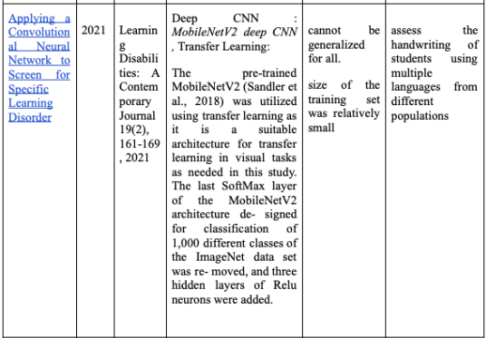
Literature Survey
Literature Survey -
6

Slide 9
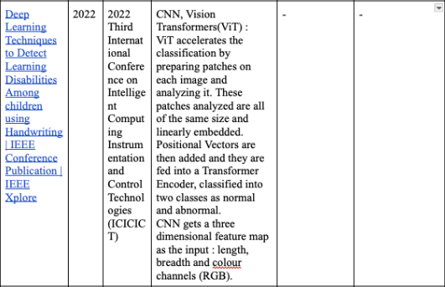
Literature Survey
Literature Survey -
7

Slide 10
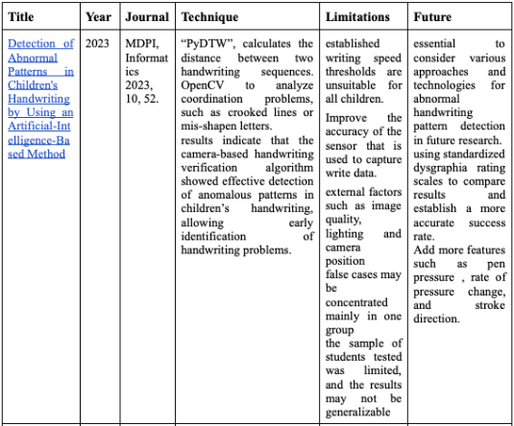
Literature Survey
Literature Survey -
8

Slide 11
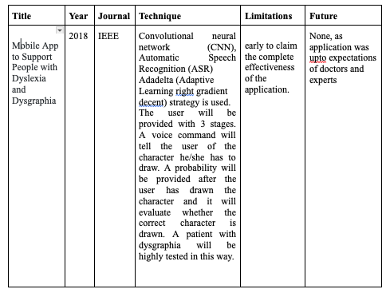
Literature Survey
9

Slide 12
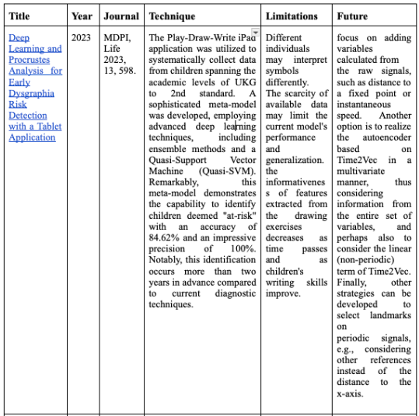
Literature Survey
10

Slide 13
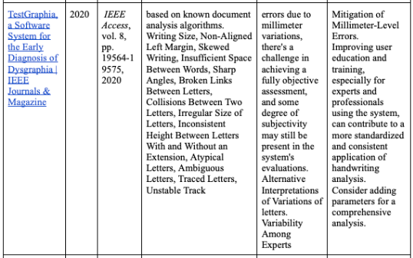
Literature Survey
Literature Survey -
11

Slide 14
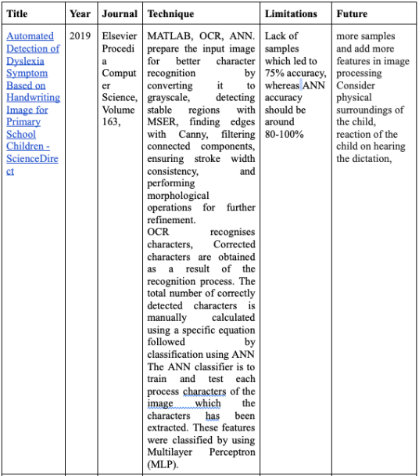
Literature Survey
12

Slide 15
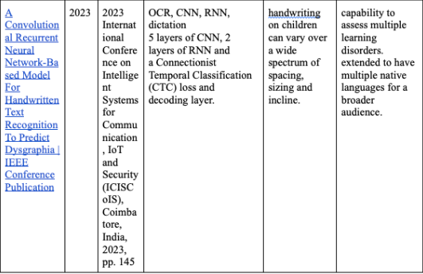
Literature Survey
Literature Survey -
13

Slide 16
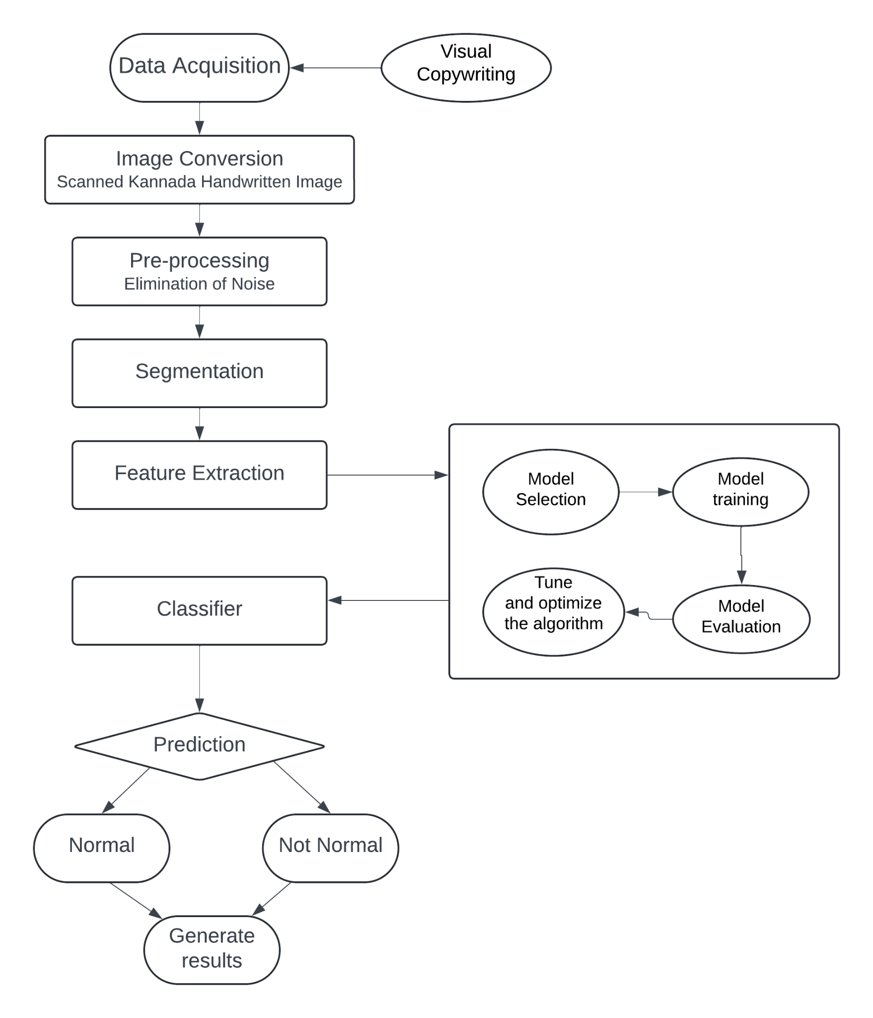
High Level Design
14

Slide 17
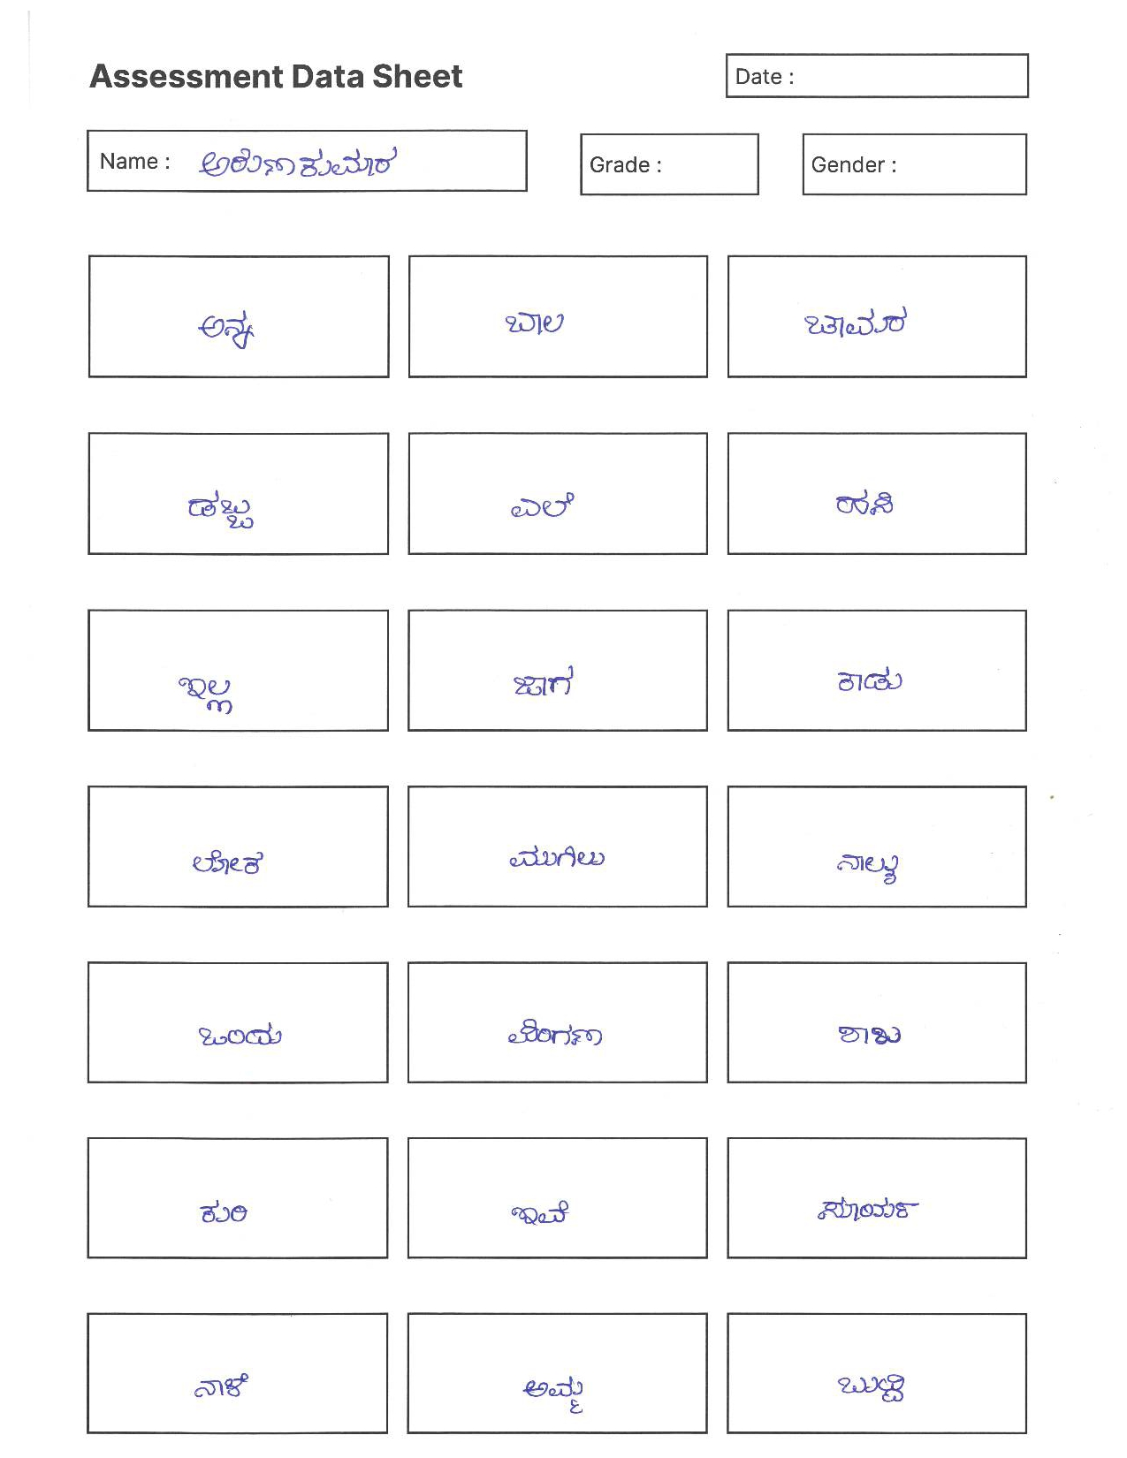
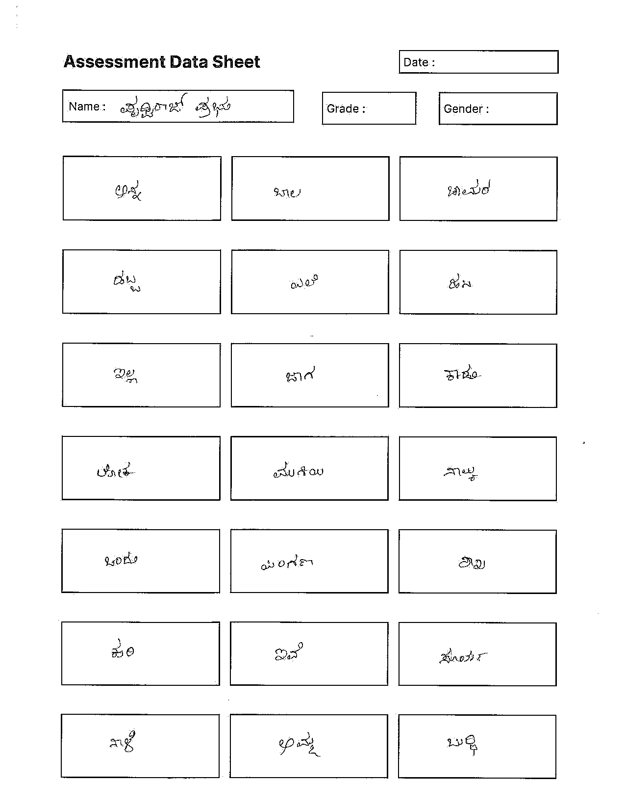
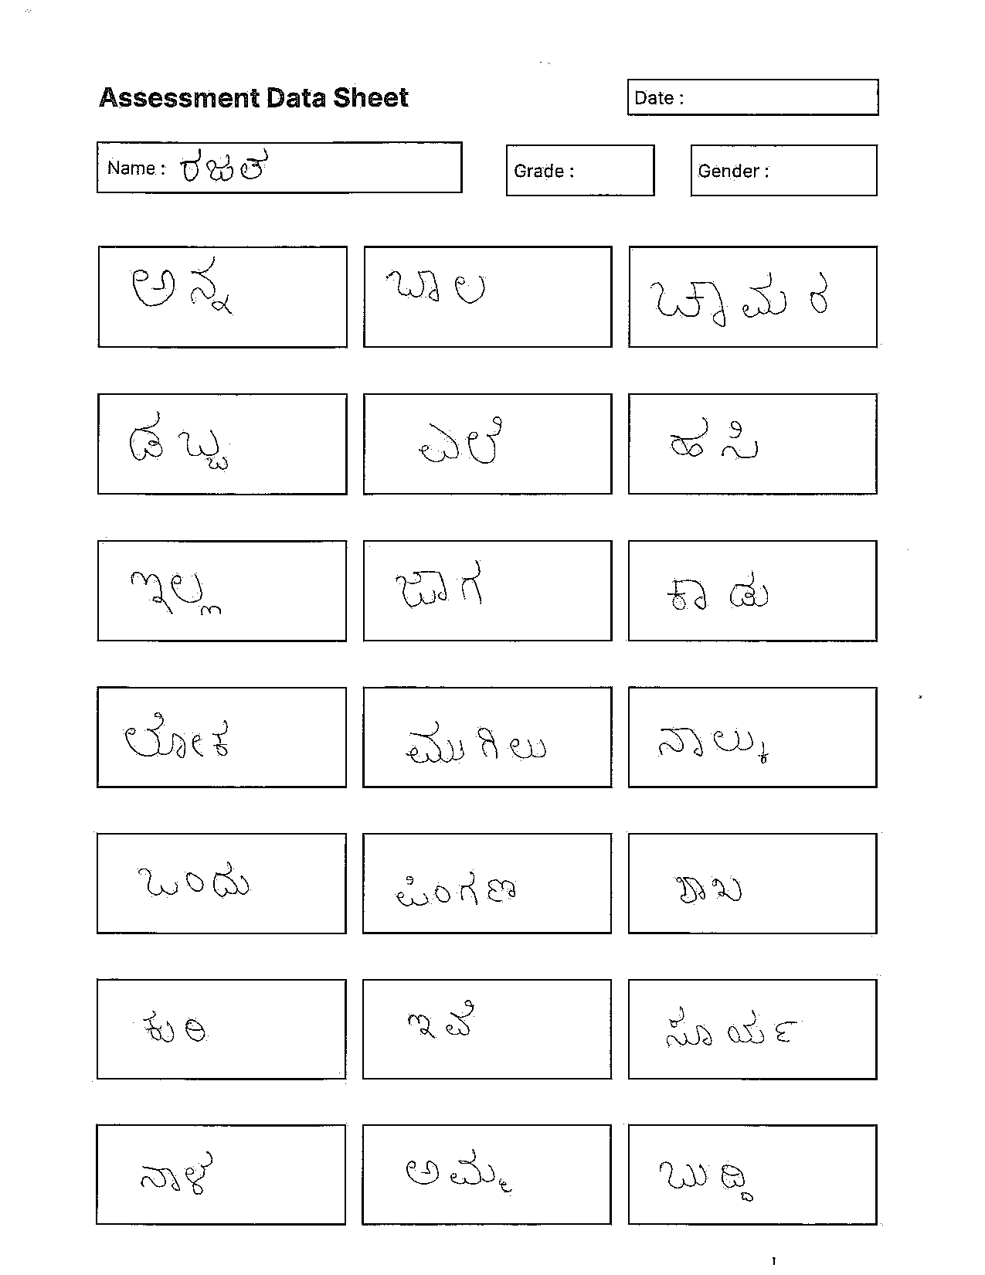
Data Acquisition
15

Slide 18
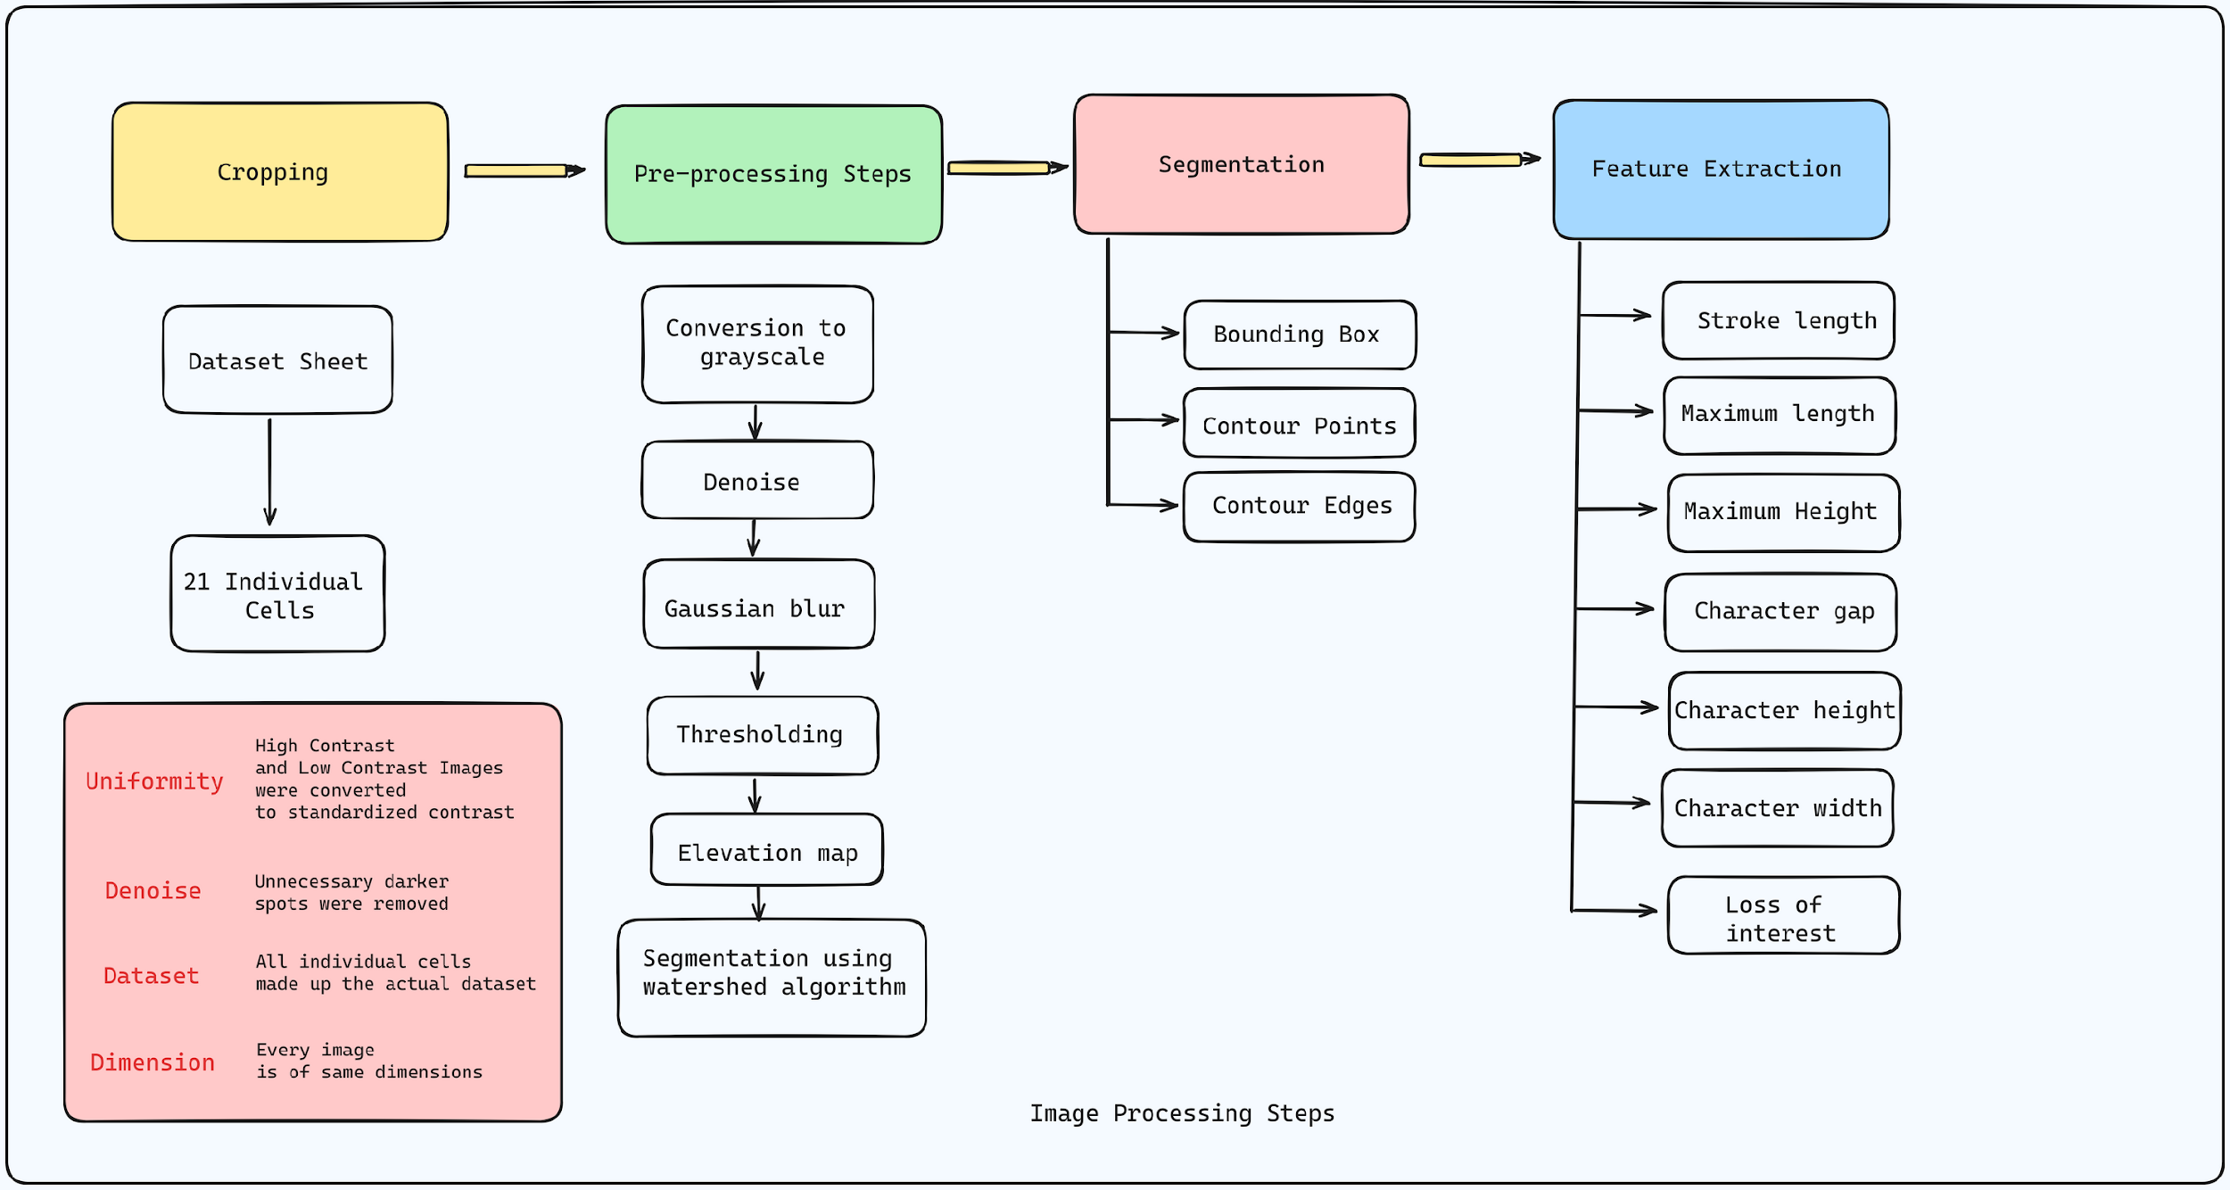
Image Preprocessing
16

Slide 19
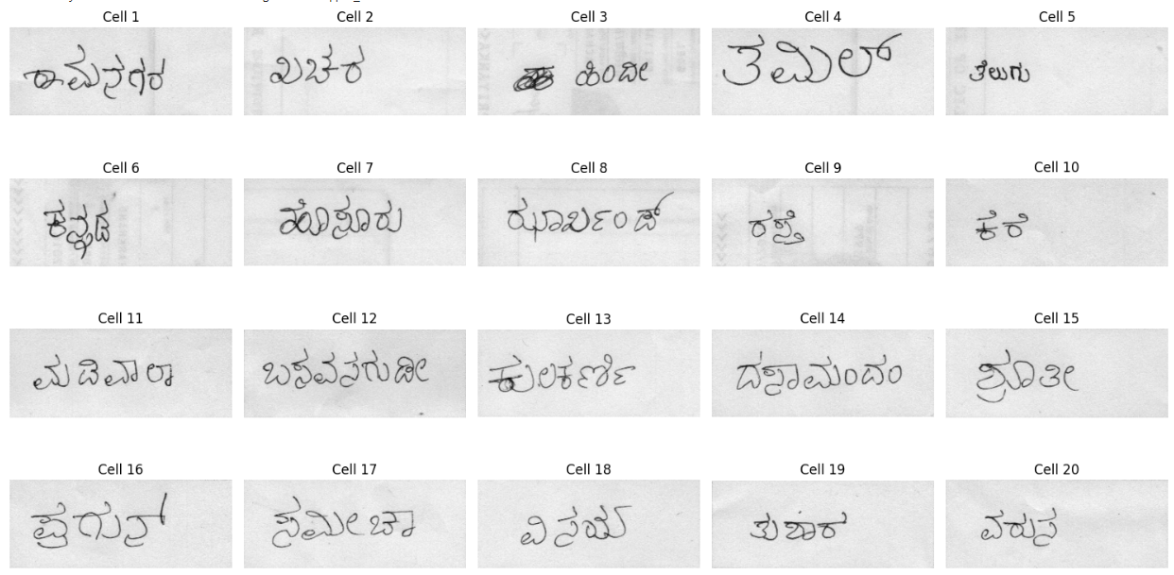
Image Preprocessing : Cropping
17

Slide 20
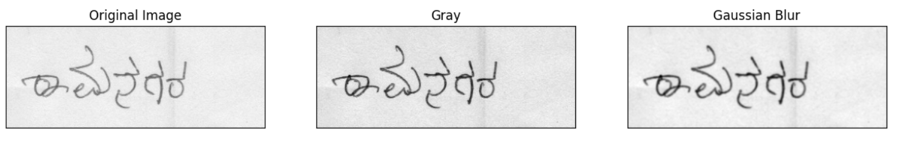
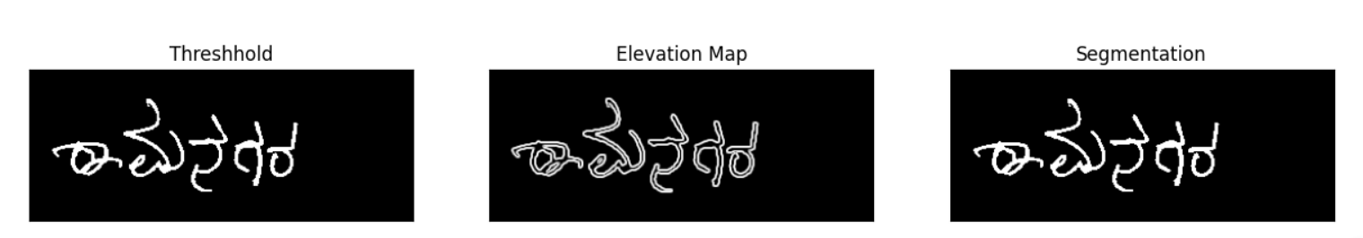
Image Preprocessing :
Pre-processing
18

Slide 21
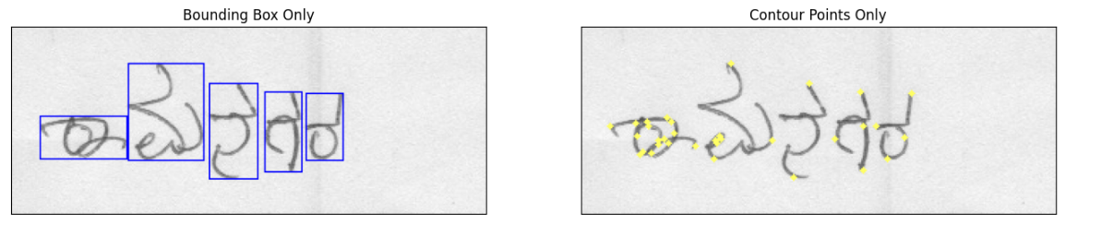
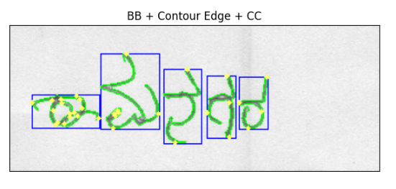
Image Preprocessing :
Segmentation
19

Slide 22
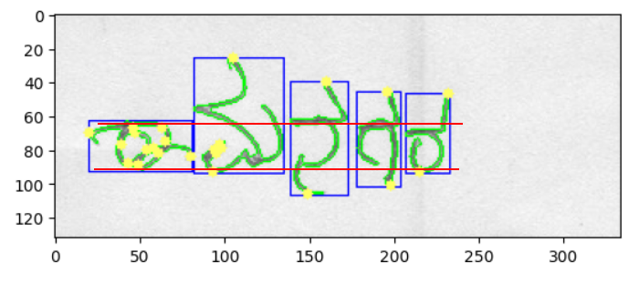
Feature Extraction
20

Slide 23
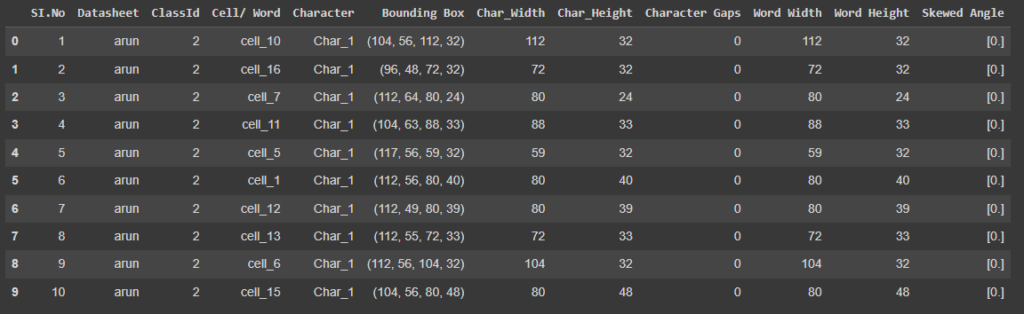
Sample Extracted Features
21

Slide 24
Proposed Models
22

Slide 25
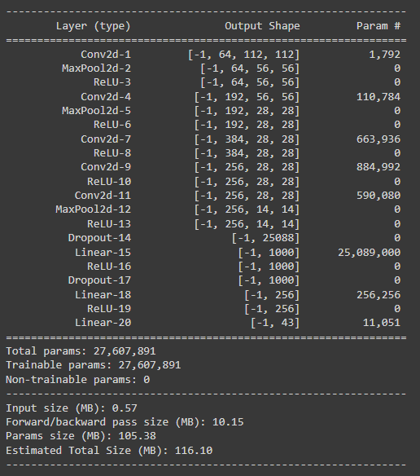
Proposed
CNN Model
23

Slide 26
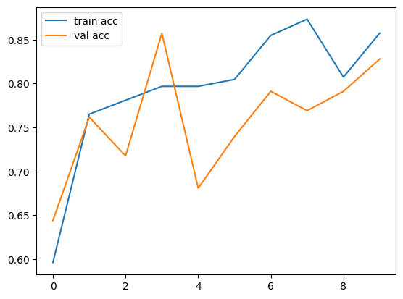
CNN model accuracy
61.8% accuracy
24

Slide 27
Model | Accuracy (%)
Custom CNN architecture model | 61.08%
Random forest classifier | 68.08%
25

Slide 28
We sincerely thank Mrs. Gayatri Kulkarni, Principal, and Mrs. Shashikala, HoD of Kannada Department, Jaigopal Garodia Rashtrotthana Vidyalaya, Bengaluru for their invaluable assistance with data collection and provision of the dataset.
Acknowledgement
26

Slide 29
Appreciation
We extend our sincere appreciation to graphologists Dr. Noothan Rao and Dr. Shivanand Nayak for generously dedicating their time and sharing invaluable insights into the handwriting aspect from a graphologist's perspective.
27

Slide 30

Thank You

